Slide 1
MOONSHOT
ITS60630 UIPG
Norman Low

Slide 2

Moonshot - “Retro shooting game”
Jet fighter must attempt to travel to the moon.
Swarm of UFOs will attack to fail the player.

Slide 3
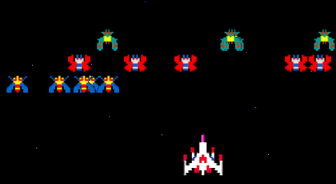
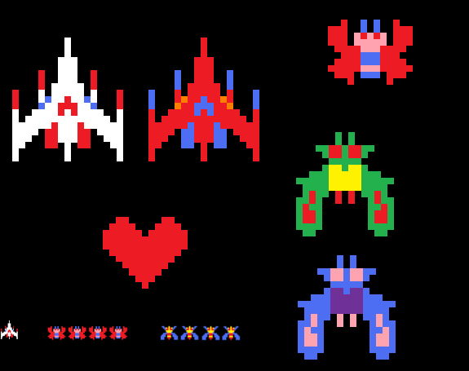
INSPIRATION

Slide 4

Menu Screen
Material Design
Simple

Slide 5
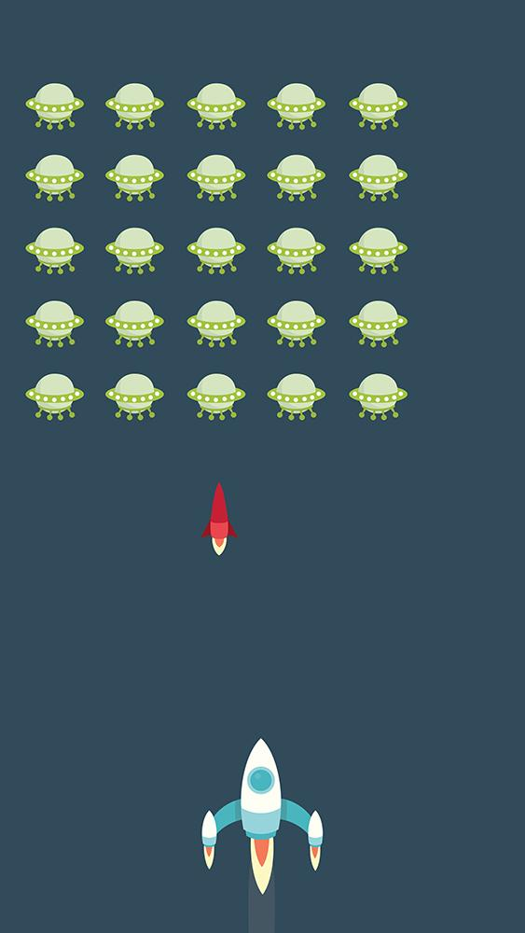



Gameplay
UFO
Missile
Player

Slide 6
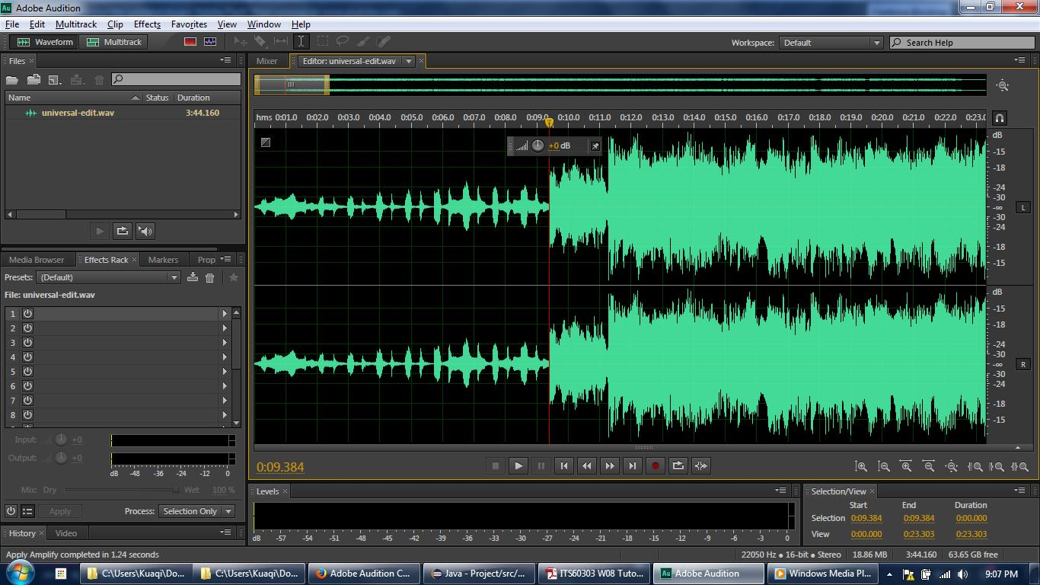
Sound Editing

